Slide 1
In Focus: Weather effects 2021-Q4
P2H

Slide 2
Temperature-dependent B2C portfolios in 2021-Q4
Short-term: high prices combined with cold and fluctuating temperatures, and underhedged portfolio
Notes:
P2H
Nov: slightly short, esp. due to cold weather.
Dec: slightly short, esp. due to low churn and underhedging.
Nov+Dec: larger-than-usual impact due to high spot prices.

Slide 3
Temperature-dependent B2C portfolios in 2021-Q4
Compounding effects
Compounding effects:
Extraordinarily high spot price level Increases negative impact of short positions.
Change in structure of spot prices Prices in Dec (where portfolio is naturally short) rose more than in Oct (where portfolio is naturally long). Even on quarter-level, positions no longer value-neutral.
Temperatures slightly below norm (esp. Nov) Causing additional short positions.
Lower churn than expected (esp. P2H) Causing additional short positions. The missing volume caused by lower churn was not procured until just before the start of the month, when prices had already risen.

Slide 4
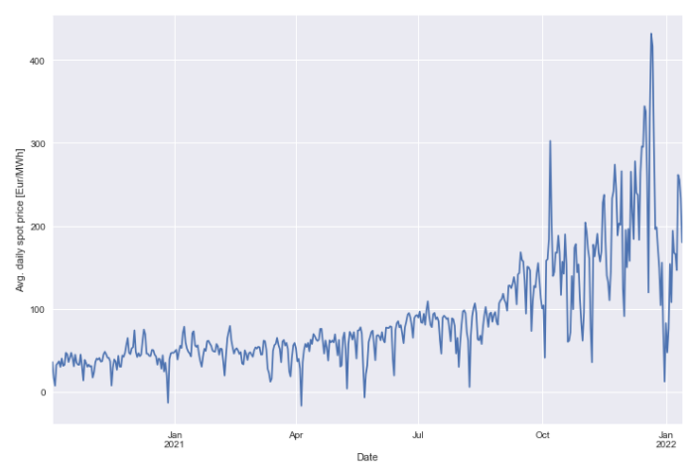
Spot prices
Spot price development (power)
since FSP 2020
Dec. 2021:
221 Eur/MWh
Very high → 400% increase between Dec 2020 and Dec 2021
Change in structure → Dec expensive compared to Oct
Dec. 2020:
44 Eur/MWh

Slide 5
Temperatures
Actual vs Norm
In November, the average temperature was 0.5°C below norm.
In December they were almost exactly on norm, but with large swings esp. towards the end of the year.

Slide 6
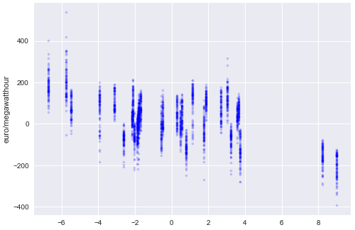
Weather influence on portfolio results
High prices combined with cold and fluctuating temperatures, and underhedged portfolio.
Two effects of weather risks:
Effect of average temperature
If actual average temperature deviates from expected average temperature, spot trade is necessary.
In 2021Q4: larger-than-usual effect, due to
Extremely high spot prices; and
Short position (because of (a) cold weather (esp. Nov.) and (b) insufficient hedging (esp. Dec.))
Effect of temperature fluctuations
In any month, temperatures fluctuate and cause spot trading at a loss (due to buying at above-avg prices and selling at below-avg prices; “covar-effect”); see graph on right.
In 2021Q4: larger-than-usual effect, due to large temperature swings (esp. Dec.)
Spot price development in Dec 2021
ΔP [Eur/MWh] = spot price vs before-month-QHPFC
ΔT [degC] = daily temperature vs monthly average

Slide 7
Influence of temperature-driven volume deviations
Exemplary calculations for P2H portfolio in 2021 Q4
 |  | Sourcing result in MEur under various price and temperature scenarios
 |  | Spot price
Temperature | Offtake | (vs Forward curve FSP2020)
change | change | +0% | +25% | +50% | +100% | +200% | +400%
(vs norm) |  | =44 Eur/MWh | =54 Eur/MWh | =65 Eur/MWh | =87 Eur/MWh | =131 Eur/MWh | =218 Eur/MWh
-0 deg C | +0 GWh | -0.7 | -1.0 | -1.3 | -1.8 | -2.9 | -5.1
-1 deg C | +40 GWh | -0.5 | -1.2 | -1.9 | -3.2 | -5.8 | -11.1
-2 deg C | +80 GWh | -0.4 | -1.4 | -2.5 | -4.6 | -8.7 | -17.1
-3 deg C | +120 GWh | -0.2 | -1.7 | -3.1 | -6.0 | -11.7 | -23.1
Actual
(Actual sourcing result 2021 Q4: -7.03 MEur)

